Slide 1


Welcome CAABC Meeting
November 7th, 2018

Slide 2

Introduction
Conducted BY:
CAUW Staff

Slide 3
Purpose & Objective of Meeting
Asset Building Coalition
By: Edy Addsion

Slide 4
VIDEO
Why an Asset Building Coalition
https://youtu.be/WAbdDLVG02Q

Slide 5

Introduction of The Middleburg Team
By: Joyce James
Dialogue

Slide 6

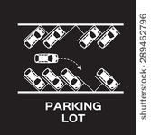



Q & A
Audience Engagement
Parking Lot Hands Down
Hands up Hands Sideway

Slide 7

Calendar of Upcoming Events
November – April 2018

Slide 8


Next
Pre-Survey and Info Tech Introduction

