Slide 1


Capital Area Asset Building Coalition
December 7th , 2018
Holiday Luncheon

Slide 2

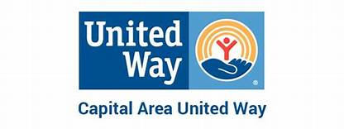
Welcome
CAUW Staff

Slide 3
RECAP Why Are We Here?
Asset Building Coalition
Joyce James
The Middleburg Institue

Slide 4
VIDEO
Thinking outside the BAYOU !
US doctors are offering free tax preparation ... - Quartz
https://qz.com/.../free-tax-help-for-low-income-families-pediatrician-and-ted-fellow-lu...
1.
VIDEO
US doctors are offering free tax preparation for low-income families right in the waiting room. Dr. Lucy Marcil wants to remind you that in the US, tomorrow (April 15) is the deadline for filing your taxes. ... Inits first two years, StreetCred helped 750 families in Boston get back $1.6 million in earned income credits.

Slide 5




Q & A
Audience Engagement
Hands Down
Hands up Hands Sideway

Slide 6

Calendar of Upcoming Events
December 18th Bank On BR Meeting 2 pm – Pelican State Credit Union Corporate Office
January 15th - Put the Fun Back into your Tax Refund Workshop Goodwood Library
January 17th 2019 CAABC Action Planning Session 9 – 3 pm United Way
February 9th – Super Tax Day Goodwood Library
February 25 – March 2nd – America Saves Week
March 2019- Site Visits https://americasavesweek.org/
April 2019- Action Session Reporting
May 2019 – Asset Building Summit – One Day –
Financial Integration

Slide 7

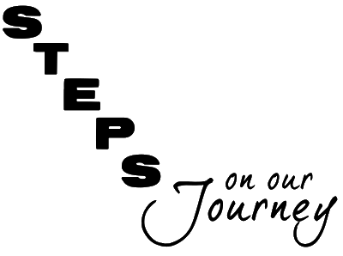
Next
Pre-Survey and Info Tech Introduction
https://caabc.info-tech.systems/take-survey/survey-2/

Slide 8
The Alice Report
WHAT DOES ALICE STAND FOR?
ALICE is a United Way acronym that stands for Asset Limited, Income Constrained, Employed.
ALICE is your child care worker, your parent on Social Security, the cashier at your supermarket, the gas attendant, the salesperson at your big box store, your waitress, a home health aide, an office clerk. ALICE cannot always pay the bills, has little or nothing in savings, and is forced to make tough choices such as deciding between quality child care or paying the rent. One unexpected car repair or medical bill can push these financially strapped families over the edge
MEET ALICE
ALICE is a hardworking member of the community who is employed yet does not earn enough to afford the basic necessities of life.
​
ALICE earns above the federal poverty level, but does not earn enough to afford a bare-bones household budget of housing, child care, food, transportation, and health care. The United Way ALICE Reports use new measures to provide a more accurate picture of financial insecurity at the state, county, and municipal level.
The United Way ALICE Project is a collaboration of United Ways in Connecticut, Florida, Hawai‘i, Idaho, Indiana, Iowa, Louisiana, Maryland, Michigan, New Jersey, New York, Ohio, Oregon, Pennsylvania, Texas, Virginia, Washington, and Wisconsin.
https://www.unitedwayalice.org/home

